Slide 1

Cover Letter

Slide 2
What is Cover Letter?
Definition:
A cover letter is a document sent with your resume to provide
additional information on your skills and experience.
It highlights the key points in your resume.
Show off your qualification to a prospective employer
It should introduce you briefly
It should reflect your attitude –make sure the tone of your
letter helps the reader to understand your personality.

Slide 3
Cover Letter Basics
Heading
Inside Address
Salutation
Paragraph 1
Paragraph 2
Closing
Signature

Slide 4
Use proper business letter format.
Keep your letter brief : 3-4 paragraphs on one page only.
Error free –no types of incorrect grammar

Slide 5
Elements of Bad Cover Letter
Poor grammar, punctuation, misspelled words
Rambling – lack of focus
Bland , boring text
Aggressive tone
Self deprecation
Don’t use CAPSLOCK or exclamation points to get your point across
Don’t Include sentences meant to impress , if they are not true

Slide 6
Types of cover Letter
Email Cover Letter
Paper Cover Letter

Slide 7
Email Cover Letter

Slide 8
Subject Line – job title , your name should sure to list the job you are applying for in the subject line of your email message, So the employer is clear as to what job you are interested in.
Salutation
Dear Mr./Ms : or Hiring Manager (if you don’t have a contact person)

Slide 9
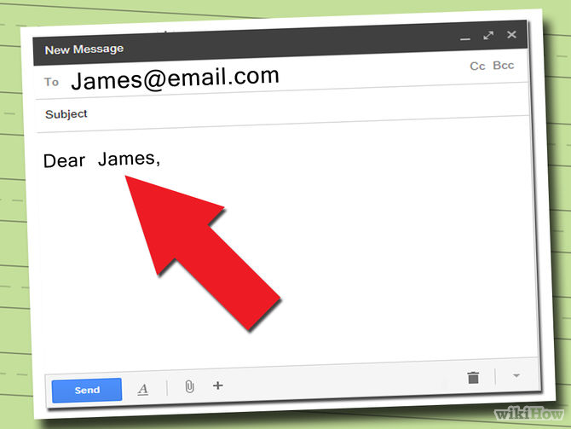
1. Include a salutation.

Slide 10
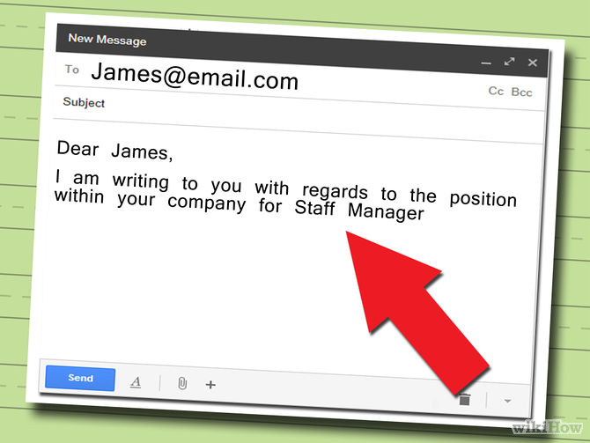
First paragraph- The 1st paragraph of your letter should include
information on why you are writing . Mention the position you are
applying for. Be clear and concise regarding your request.

Slide 11
Middle Paragraph: Mention specifically how your skills
and experience match the job you are applying for.
Last Paragraph: If you attached your resume mention it
In this paragraph then conclude your cover letter by
Thanking the employer for considering you for position.
Include the information on how you will follow-up.
Complimentary Close: End your cover letter with a
respectful closing statement.
"Best" or "Sincerely" are both classic options

Slide 12
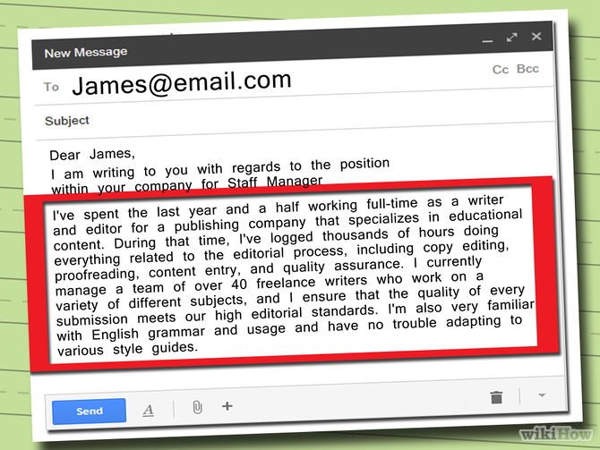

Slide 13
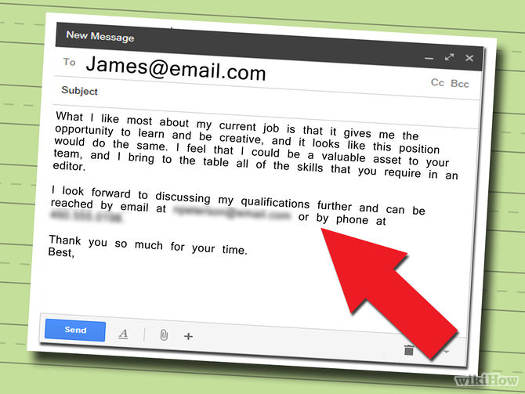

Slide 14
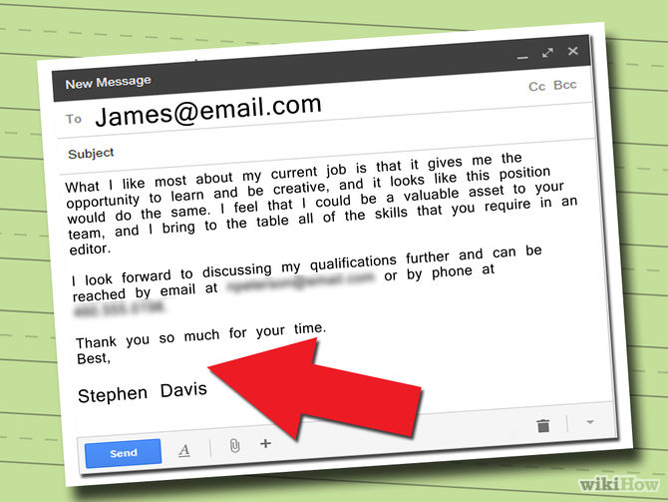
Signature : include your name , full address , phone no.
email address. So.it is easy for hiring manager contacts to
get in touch.

Slide 15
Paper Cover Letter

Slide 16
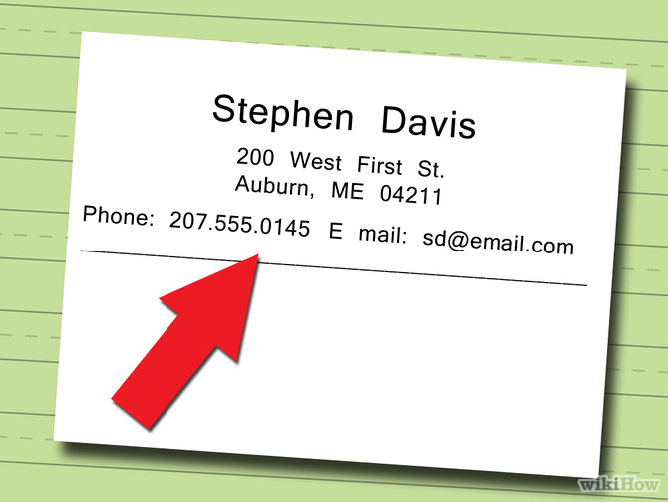
1. Add a letterhead at the top of the letter.

Slide 17
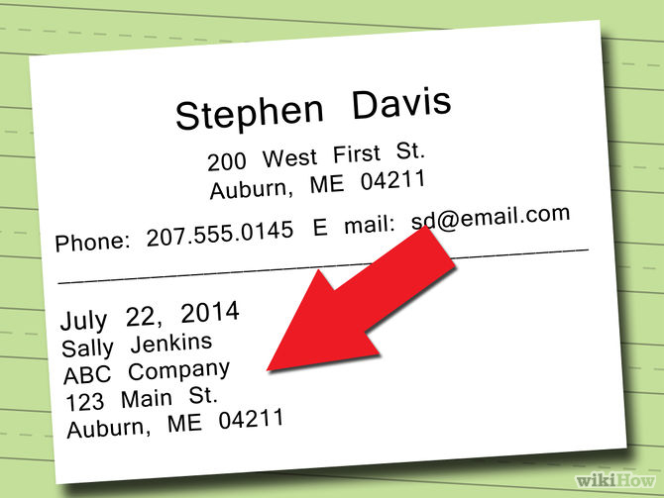
2. Write the recipient’s name and address and the date below
the letterhead.

Slide 18
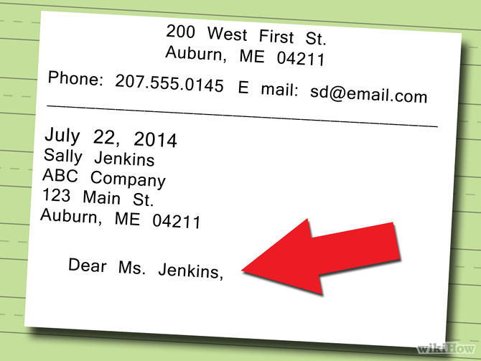
3. Address the recipient. Be sure to refer to the recipient by his or her proper title (Mrs., Mr., Dr., etc.).

Slide 19
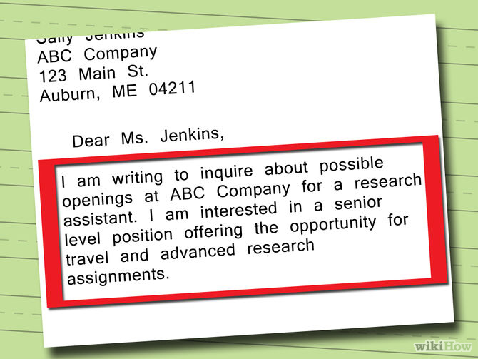
4. State your purpose in the first paragraph. Tell the employer why you are writing to them in two or three sentences. State the position for which you are applying (or the one you would like to have should it become available).

Slide 20
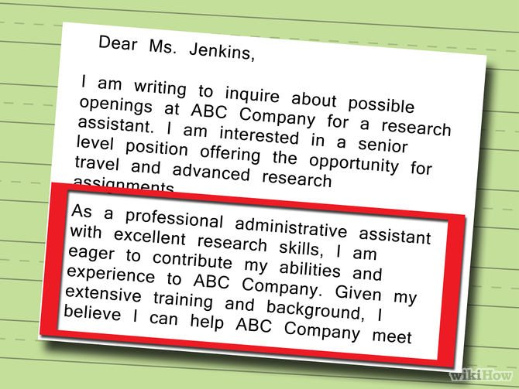
5. Outline your qualifications in the middle paragraph(s).

Slide 21
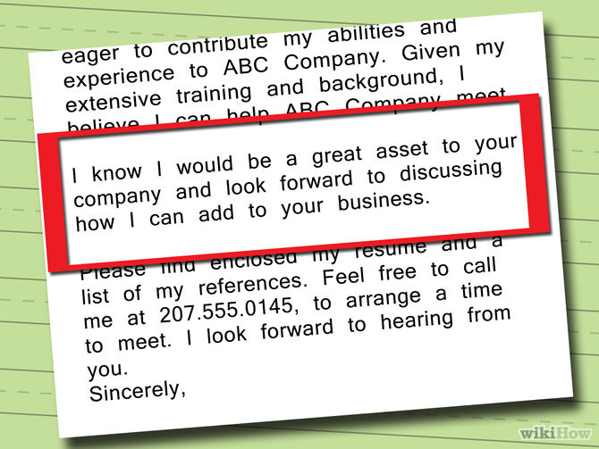
6. Include a positive statement or question in the final paragraph that will motivate the employer to contact you.

Slide 22
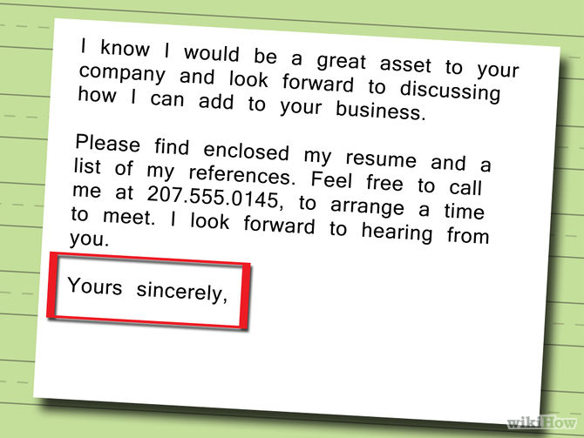
7. Write an appropriate closing.
It’s a good idea to thank the reader for his or her time. After that, write “Sincerely,” “Respectfully,” or “Regards,” leave several spaces, and print your name.

Slide 23
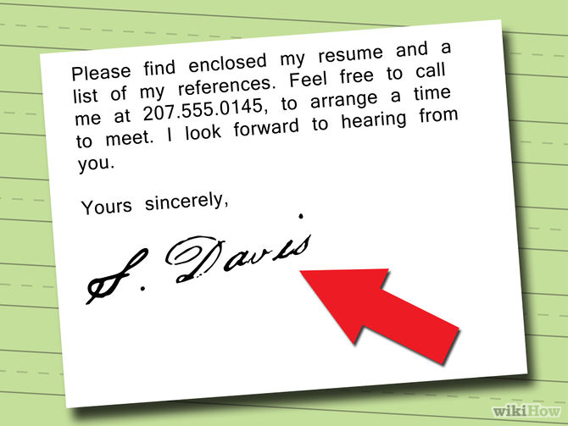
8. Add your signature.

Slide 24
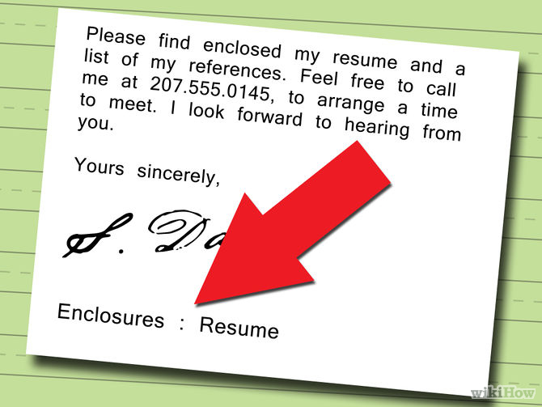
9. Make a notation of the enclosures. If you enclose something, such as a resume, with a letter, you should indicate that the letter contains enclosures by making the notation “Enclosure” or “Enclosures” at the bottom of the letter.

Slide 25
Job Application

Slide 26
What is Job Application?
Definition:
A job application is a form employers use to collect information about you to see if you are a good fit for the position. There are usually four parts of a job application:
Personal information
Employment information, also called work history
Education and training
References.
The job application letters you send explain to the employer why you are qualified for the position and why you should be selected for an interview. Use the letter to
Highlight relevant information from your resume, without duplicating it.

Slide 27
Contents of Job Application
Your Name & Contact
Employer’s Name & Address
Date
Addressing the Employer
State the Position
Why You?
Qualification
Experience
Contribution towards the Company
Thanking the Employer for Reading
Appropriate Ending
Signature and Name

Slide 28
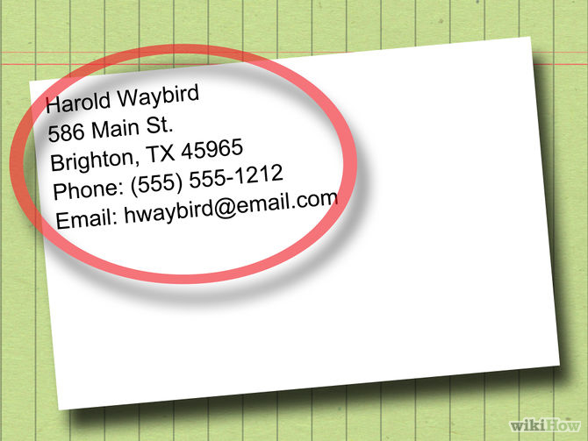
1. Begin by adding your contact information at the top.

Slide 29
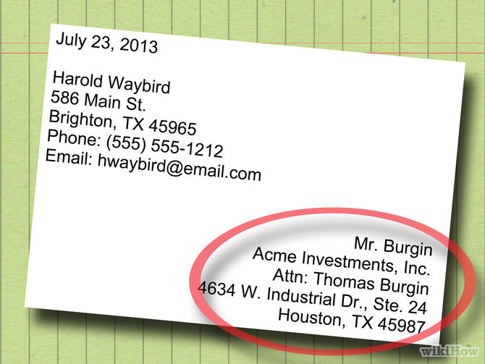
2. Write the name of the employer to whom you are applying for
the job. Include the address.

Slide 30
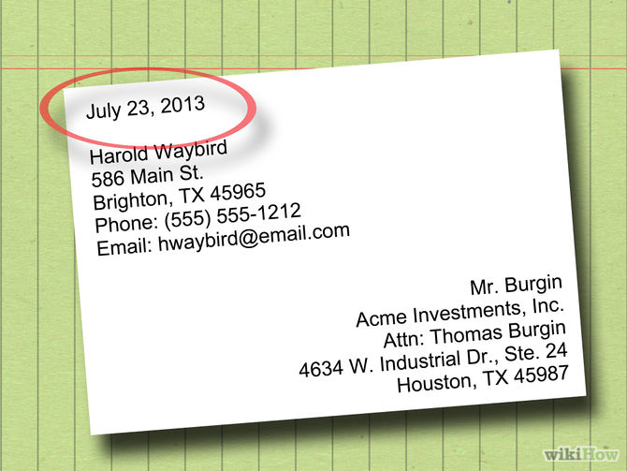
3. Write the date in the letter.

Slide 31
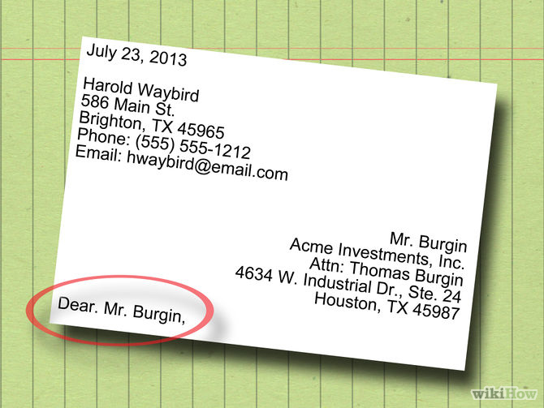
4. Write the name of the person to whom you are writing.

Slide 32
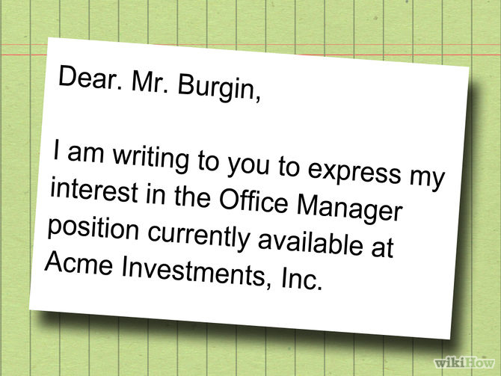
5. State the position to which you are applying so that the
employer knows for certain.

Slide 33
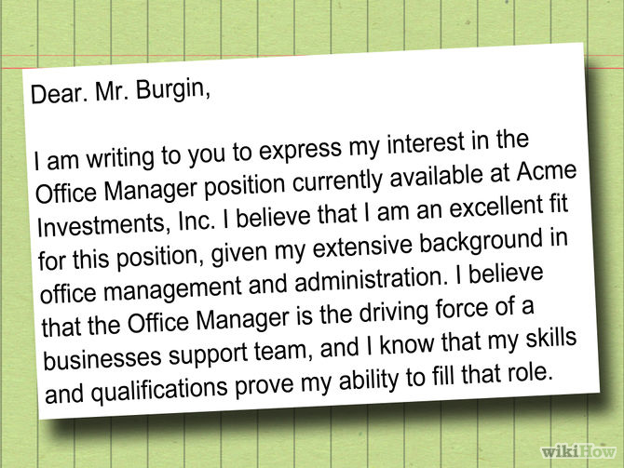
6. Begin the letter by telling the employer why you want the job.

Slide 34
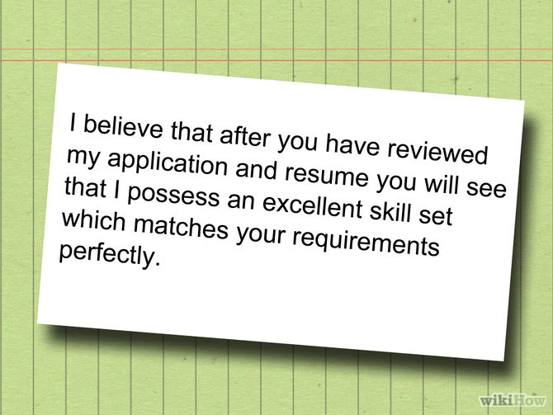
7. In the next paragraph, summarize your strengths and any particular
qualifications or experience that would be considered relevant to
the post.

Slide 35
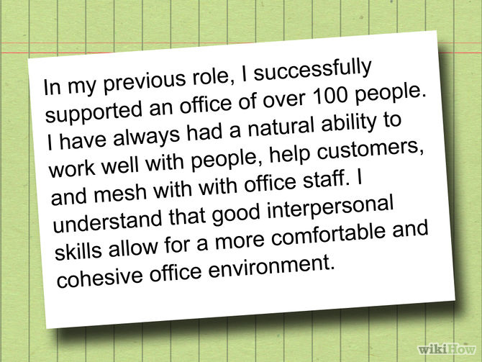
8. Include the most relevant aspects of your career in the
next paragraph.

Slide 36
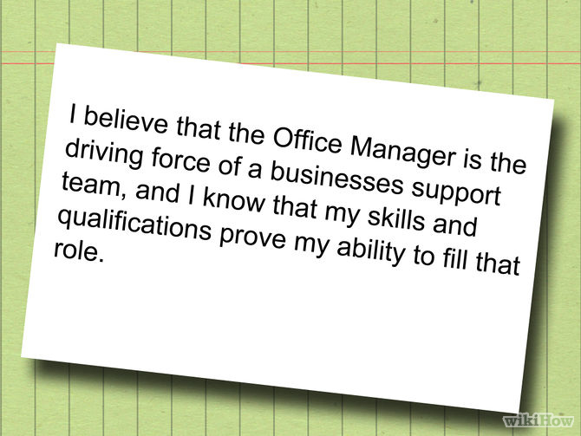
9. Finally, explain how you think you can contribute to the company
and help it become successful.

Slide 37
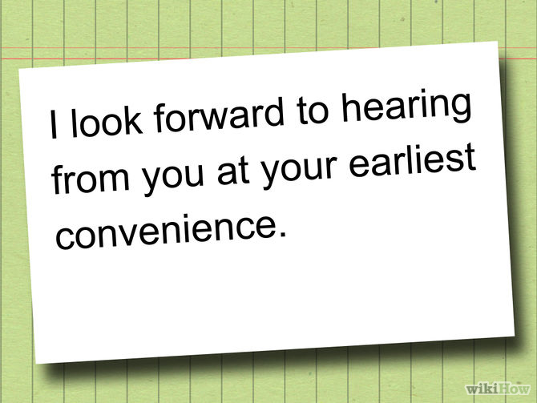
10. Before Closing write I look forward to hearing from you at
your earliest convenience.

Slide 38
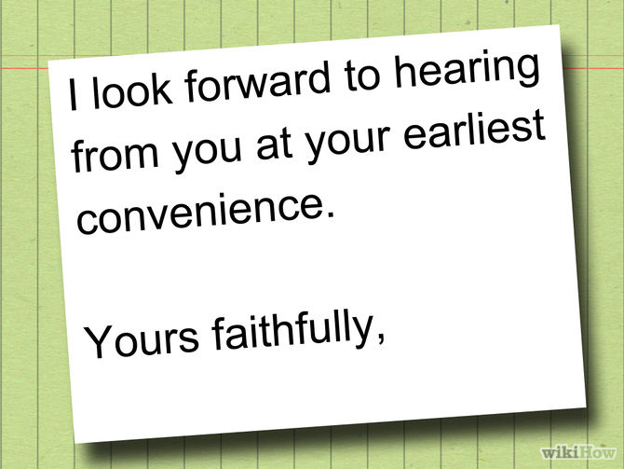
11. End appropriately. Use Yours sincerely or Yours faithfully.

Slide 39
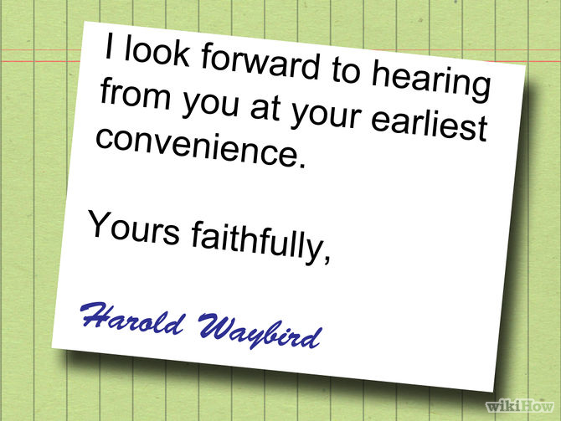
12. Sign and write your name underneath.

Slide 40

July 23, 2018
Muhammad Shakeel
586 Main St.
Bahawalnagar, TX 45965
Phone: (555) 555-1212
Email: muhammadshakil14@gmail.com
Acme Investments, Inc.
Attn: Thomas Burgin
4634 W. Industrial Dr., Ste. 24
Houston, TX 45987
Dear. Mr. Burgin,
I write to apply for the Office Manager position at Acme Investments, Inc. I am an excellent fit for
this position, as demonstrated by my extensive background in office management and proven
success as a corporate administrator.
In my previous role, I successfully supported an office of 100 personnel. In this position I honed
my interpersonal skills through customer service, clerical responsibilities.
I believe that I possess the temperament and experience to excel in this position. Not only am
I well organized but I have a passion for creating positive and productive work environments.
Through observation and asking detailed questions I believe that I will have a significant impact
on the daily operations of Acme Investments.
I look forward to hearing from you about the progress of my application.
Yours sincerely,
Muhammad Shakeel

Slide 41
Difference Between Job Application And Cover Letter

Slide 42
Focus:
When writing an application letter, the three main areas of focus are
1) you want to catch the reader’s attention,
2) provide a convincing argument that you are qualified for the job
3) request an interview for the position.
The focus of the cover letter is to simply identify yourself as the sender, along with the person to whom you are sending the information and the reason for it being sent.

Slide 43
Content:
For the application letter, provide as many details about your qualifications as possible. Include your overall objective, previous work and leadership experience, educational background, special skills and contact information.
On the cover letter, include contact information for yourself and the person to whom you are sending the documents. You should also add a brief explanation of why you are sending the
information.

Slide 44
Format:
An application letter should be one typed page including three paragraphs.
Introduce yourself and your objective in the first paragraph,
Sell yourself in the second paragraph
Ask for an interview in the third paragraph.
The cover letter should feature the complete contact information for the person receiving the documents, along with a few sentences explaining the material and the sender’s name and contact information

Slide 45
Function:
The function of an application letter is to “market your skills, abilities and knowledge.” The application letter serves to supplement your résumé and/or formal application.
On the other hand, the cover letter simply acknowledges the transmission of the documents.

Slide 46
Importance:
The application letter should accompany a résumé in most situations.
A cover letter is typically only necessary when electronically delivering the documents, such as over fax or email.

Slide 47
COMMON MISAKES IN COVER AND JOB LETTERS

Slide 48
Failing to personalize
Avoid saying, "Dear Sir or Madam" and take the initiative to find out the appropriate contact name. Often a quick phone call to the company can help you fill in the blank. You'll show that you're resourceful and truly interested in the job.

Slide 49
Starting off weak
Your opening paragraph should capture the reader's attention.
So, rather than simply saying,
"I am applying for the programmer position posted at AnytownPaper.com,“
follow up with,
"Your need for an experienced professional is a good match for my five years of experience in publishing and extensive background as a programmer. “

Slide 50
Being generic
Don't send the same cover letter to all companies. Take the time to do some basic research of prospective employers so you can customize them.
In a survey by a company, only 44 percent of executives polled said it's common for applicants to use their cover letters to show they've learned more about the job; so if you make the effort, you'll already be ahead of half your competition.

Slide 51
Underselling your talents
Give hiring managers a compelling reason to call you in for an interview.
Instead of saying you have strong communication skills, provide examples: "I recently led a training session on a new database application and received significant praise for my ability to relay complex information to a non-tech-oriented audience."

Slide 52
Trying to be witty or humorous
This can backfire, so it's best to stick with a business letter format, even with e-mailed job and cover letters. A professional yet conversational tone and salutations such as "Mr." and "Ms." will help you be taken seriously.

Slide 53
Focusing too much on yourself
While you want to sell your qualifications, don't forget to explain how you would add value to the company.
If your cover letter is dominated with "I," chances are you need to focus more of your content on the prospective employer.

Slide 54
Failing to proofread
As qualified as you may be for the opening, you're likely to fall out of contention if your letter is full of typos, misspellings and grammatical errors.

Slide 55
The following examples from real cover letters prove just how important this can be:
"I'm attacking my resume for you to review."
"I prefer a fast-paste environment."
"I never take anything for granite."

